Slide 1
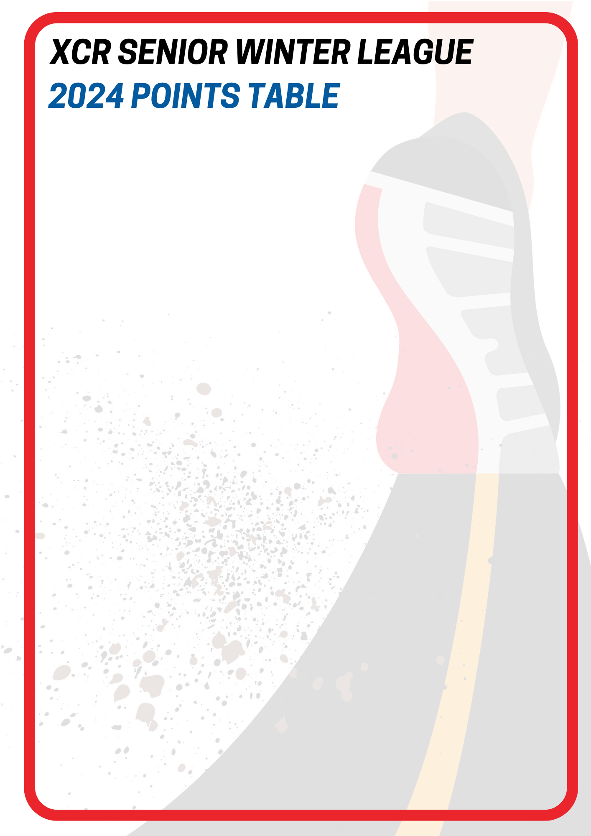
OVERALL – after Round 4
# | Club |  | Points
1 |  | Pakuranga Athletics | 69
2 |  | Owairaka | 63
3 |  | ACA | 50
3 |  | TTT Runners | 50
5 |  | YMCA | 48
5 |  | Night Ninjas | 48
7 |  | Whippets Running Project | 46
8 |  | Lynndale | 26
9 |  | University | 23
10 |  | Oratia | 18
11 |  | Wesley | 13
12 |  | Papakura | 8
13 |  | Glen Eden | 5
13 |  | North Harbour Bays | 5

Slide 2
U18 / U20’s MEN – after Round 4
# | Club |  | Points
1 |  | ACA | 16
2 |  | Pakuranga Athletic Club | 13
3 |  | Whippets Running Project | 7
4 |  | Lynndale Athletic Club | 6
U18 / U20’s WOMEN – after Round 4
# | Club |  | Points
1 |  | ACA | 16
2 |  | TTT | 7
3 |  | Lynndale Athletic Club | 6

Slide 3
SENIOR MEN – after Round 4
# | Club |  | Points
1 |  | Whippets Running Project | 23
1 |  | Pakuranga Athletic Club | 23
3 |  | Owairaka | 18
4 |  | Oratia | 6
5 |  | ACA | 4
6 |  | Night Ninjas | 3
7 |  | TTT | 2
8 |  | Glen Eden | 1
SENIOR WOMEN – after Round 4
# | Club |  | Points
1 |  | Whippets Running Project | 8
2 |  | TTT | 7
3 |  | Owairaka | 6
4 |  | Bays | 5
5 |  | Glen Eden | 4
6 |  | Lynndale | 3

Slide 4
MASTERS MEN (35-49) – after Round 4
# | Club |  | Points
1 |  | Night Ninjas | 26
2 |  | Pakuranga Athletic Club | 20
3 |  | Wesley | 13
4 |  | Owairaka | 12
5 |  | Whippets Running Project | 8
6 |  | ACA | 6
7 |  | Oratia | 5
8 |  | TTT | 4
9 |  | Lynndale Athletic Club | 2
MASTERS MEN (50+) – after Round 4
# | Club |  | Points
1 |  | Auckland University | 23
2 |  | Owairaka | 22
3 |  | Night Ninjas | 19
4 |  | YMCA | 16
5 |  | Pakuranga Athletic Club | 7
6 |  | TTT | 6
7 |  | Papakura | 5
7 |  | Lynndale Athletic Club | 5

Slide 5
MASTERS WOMEN (35-49) – after Round 4
# | Club |  | Points
1 |  | TTT | 16
2 |  | YMCA | 8
3 |  | Oratia | 7
4 |  | Pakuranga Athletic Club | 6
5 |  | Owairaka | 5
6 |  | Lynndale Athletic Club | 4
7 |  | Papakura | 3
MASTERS WOMEN (50+) – after Round 4
# | Club |  | Points
1 |  | YMCA | 24
2 |  | TTT | 8

