Slide 1
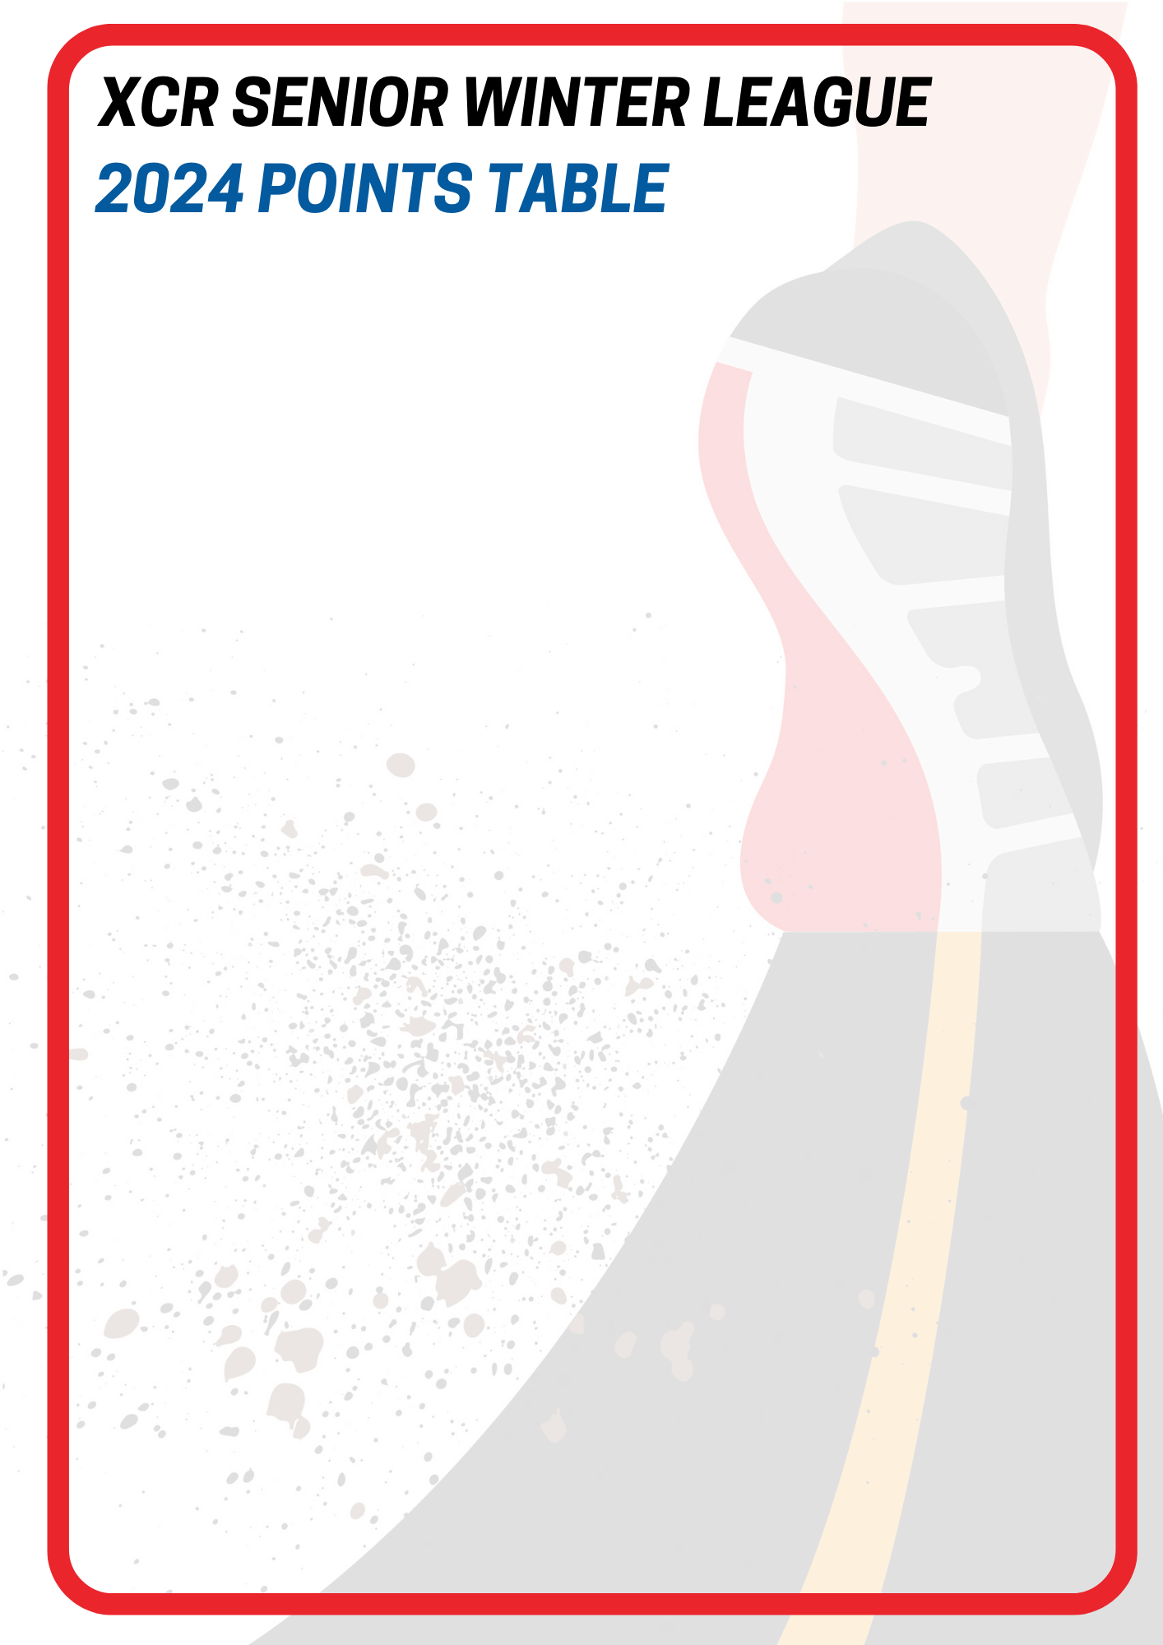
OVERALL – after Round 9
# | Club |  | Points
1 |  | Night Ninjas | 173
2 |  | Owairaka | 163
3 |  | Pakuranga Athletic Club | 104
4 |  | Whippets Running Project | 85
5 |  | ACA | 80
6 |  | YMCA | 75
7 |  | TTT Runners | 65
8 |  | Auckland University | 50
9 |  | Oratia Running | 32
10 |  | Lynndale Athletic & Harrier Club | 31
11 |  | Wesley | 28
12 |  | North Harbour Bays | 21
13 |  | Papakura | 8
14 |  | Glen Eden | 5

Slide 2
U18 / U20’s MEN – after Round 9
# | Club |  | Points
1 |  | ACA | 31
2 |  | Pakuranga Athletic Club | 27
3 |  | Whippets Running Project | 22
4 |  | Lynndale Athletic & Harrier Club | 11
5 |  | Oratia Running | 8
U18 / U20’s WOMEN – after Round 9
# | Club |  | Points
1 |  | ACA | 32
2 |  | TTT Runners | 7
3 |  | Lynndale Athletic & Harrier Club | 6

Slide 3
SENIOR MEN – after Round 9
# | Club |  | Points
1 |  | Whippets Running Project | 47
2 |  | Owairaka | 34
3 |  | Night Ninjas | 24
4 |  | Pakuranga Athletic Club | 23
5 |  | Oratia | 12
6 |  | ACA | 4
7 |  | TTT Runners | 2
8 |  | Glen Eden | 1
SENIOR WOMEN – after Round 9
# | Club |  | Points
1 |  | North Harbour Bays | 21
1 |  | Owairaka | 21
3 |  | TTT Runners | 15
4 |  | Whippets Running Project | 8
5 |  | Glen Eden | 4
6 |  | Lynndale Athletic & Harrier Club | 3

Slide 4
MASTERS MEN (35-49) – after Round 9
# | Club |  | Points
1 |  | Night Ninjas | 63
2 |  | Pakuranga Athletic Club | 35
3 |  | Owairaka | 34
4 |  | Wesley | 28
5 |  | Whippets Running Project | 8
6 |  | ACA | 6
7 |  | Oratia | 5
8 |  | TTT Runners | 4
9 |  | Lynndale Athletic & Harrier Club | 2
10 |  | YMCA | 1
MASTERS MEN (50+) – after Round 9
# | Club |  | Points
1 |  | Night Ninjas | 55
2 |  | Auckland University | 50
3 |  | Owairaka | 48
4 |  | YMCA | 26
5 |  | Pakuranga Athletic Club | 7
5 |  | ACA | 7
7 |  | TTT Runners | 6
8 |  | Lynndale Athletic & Harrier Club | 5
8 |  | Papakura | 5

Slide 5
MASTERS WOMEN (35-49) – after Round 9
# | Club |  | Points
1 |  | TTT Runners | 23
1 |  | YMCA | 16
3 |  | Owairaka | 11
4 |  | Night Ninjas | 8
5 |  | Oratia | 7
6 |  | Pakuranga Athletic Club | 6
7 |  | Lynndale Athletic & Harrier Club | 4
8 |  | Papakura | 3
MASTERS WOMEN (50+) – after Round 9
# | Club |  | Points
1 |  | YMCA | 32
2 |  | TTT Runners | 8
2 |  | Owairaka | 8

